Slide 1

Adventure Work Sales Analysis
Group – 2

Slide 2
Table of Contents
1
Introduction
2
Data Overview
3
Key Components
4
Product Analysis
5
Customer Analysis
6
Dashboard
7
Key Learnings
8
Conclusion

Slide 3
Introduction
Adventure Works Cycles is a leading multinational manufacturing company specializing in metal and composite bicycles, along with components, accessories, and clothing sold worldwide.
Our project utilizes the Adventure Works Sales dataset to analyze key sales performance metrics and provide actionable insights.
Detailed customer and product insights to understand business performance.
Key highlights such as:
Top-performing customers and products by category.
KPIs: Total Sales, Total Profit, Revenue, and Total Orders.
A comprehensive view of regional sales trends and monthly performance.

Slide 4
Data Overview
Important Dataset Features
Customer: Detailed information about customers, including their profiles, Occupation and income levels.
Product: Comprehensive data on products, categorized into various product categories and further divided into sub-categories for detailed analysis.
Territory: Information about sales locations, highlighting regional trends and revenue distribution across countries.
Sales: In-depth information on sales performance, covering KPIs such as total revenue, total profit, and the number of orders.

Slide 5
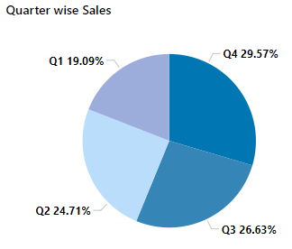
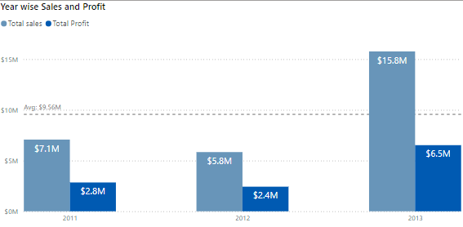
How Well The company Is Performing?
Sales and Profit Trend Total Sales experienced significant growth, rising from $7.1M in 2011 to $15.8M in 2013, showcasing a strong upward trend in revenue over the years. Among all metrics, Total Profit displayed the most notable trend, increasing dramatically from $2.8M in 2011 to $6.5M in 2013, highlighting a significant improvement in profitability.
Quarter-wise Sales Performance Quarter 4 leads with the highest sales, contributing 31% ($8.48M) of total sales, showcasing peak performance during the year. On the lower end, Quarter 1 recorded the least sales at 19.09% ($5.48M), while Quarter 2 contributed 24.71% ($7.09M) to the overall sales. This analysis highlights Quarter 4 as the most profitable period, indicating potential opportunities for maximizing revenue during this time.

Slide 6
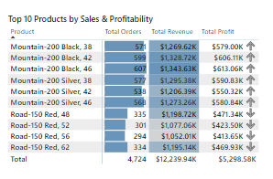
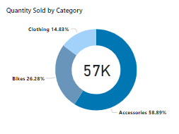
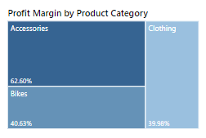
Product Performance Analysis
Mountain-200 Black, 38 leads in both Total Revenue ($1,269.62K) and Total Profit ($579.00K), While The Road-150 series exhibits a balanced contribution to revenue but less profitability compared to the Mountain-200 series
This data highlights the need to prioritize the Mountain-200 series for targeted marketing and optimized inventory management .
Accessories lead with 59.76% of total quantity sold, showing strong demand, followed by the Bikes 25.17%. This breakdown emphasizes the need to maintain strong inventory levels for Accessories and explore strategies to boost demand for Clothing.
Accessories as the most profitable category, with a 62.60% margin, Bikes, with a 40.63% margin And Clothing, at 40.15%. This suggests focusing more on Accessories for higher returns, Strategies require to optimize costs or pricing for Clothing could enhance overall profitability in this segment.

Slide 7
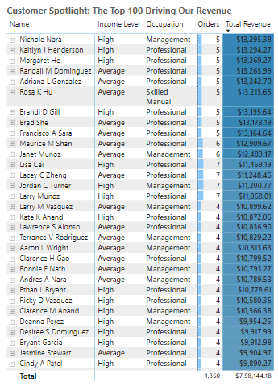
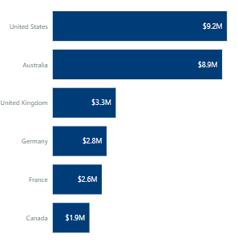
Customer Performance Analysis
The Customer Spotlight highlights the top 100 customers driving revenue, categorized by income level and occupation. Customers with Higher Income levels and Professional/Management backgrounds contribute the most to revenue. Targeting High-Income and Professional Customer Segments with tailored promotions can maximize the sales
The largest sales for Adventure Works Cycles were made in the United States, generating $9.2 million in revenue, followed closely by Australia with $8.9 million. In contrast, Canada recorded the lowest revenue at $1.9 million, which is 374.75% lower than the revenue generated in the United States.

Slide 8
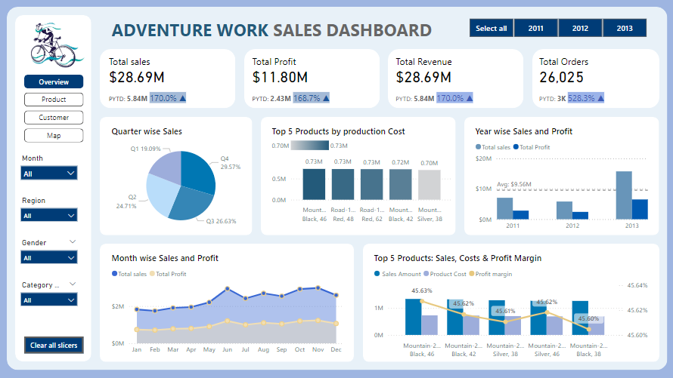
Adventure Work Sales – Power Bi Dashboard (Overview)

Slide 9
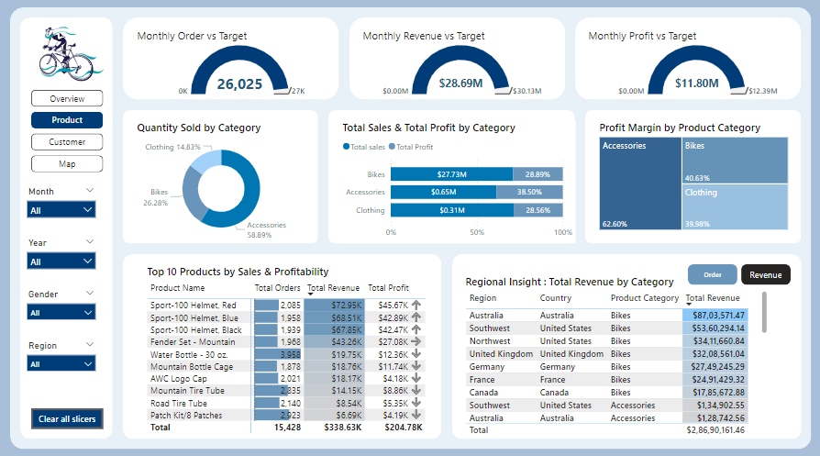
Adventure Work Sales – Power Bi Dashboard (Product Analysis)

Slide 10
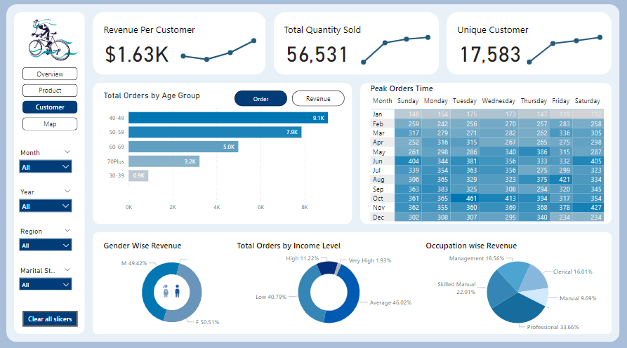
Adventure Work Sales – Power Bi Dashboard (Customer Analysis)

Slide 11
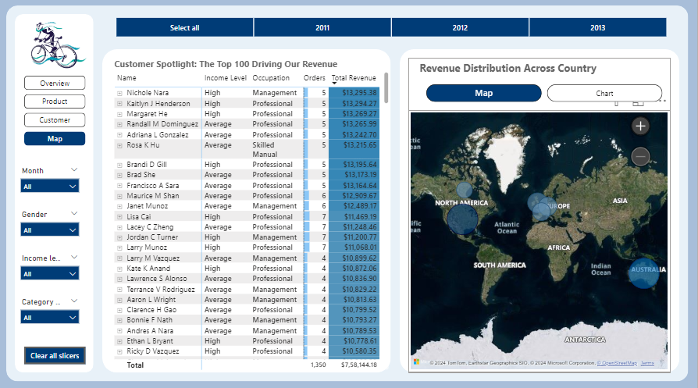
Adventure Work Sales – Power Bi Dashboard (Map)

Slide 12
Key Learnings
Overall Business Performance
Revenue and Profit: The company achieved a total revenue of $28.M and a profit of $11.80M, showcasing strong profitability.
Order Volume: A total of 26,025 orders were processed, reflecting steady customer engagement.
Top Products and Categories
High-Performing Categories: Accessories and Bikes are the top contributors to sales and revenue, with Accessories yielding the highest profit margins (62.60%).
Top Individual Products: Items like the Mountain Bikes dominate sales and profit figures, making them essential for inventory and promotional strategies.
Customer Insights
High-income professionals and Management-level individuals are the key drivers of revenue.
Regional Insights
United States and Australia lead in sales, while Canada shows growth potential.
Sales Trend
Yearly Sales experienced significant growth in year 2013 whereas, Monthly Sales peak in Q4, reflecting strong seasonal demand.

Slide 13
Conclusion
To drive future growth, prioritize high-performing categories like Accessories (62.60% profit margin) and Bikes while optimizing underperforming products in Clothing. Launch targeted regional campaigns in untapped markets like Canada and strengthen high-performing regions such as United States & Australia with exclusive offers. Focus on high-value customers, offering personalized discounts to professionals while expanding the customer base with budget-friendly options. Leverage seasonal trends by boosting inventory and promotions during peak months (Q4) and introducing creative campaigns during slow periods. Regularly monitor performance using dashboards, update data insights, and align teams for seamless execution and progress tracking.

Slide 14
Thank You!

